Slide 1
Machine Learning Certification Training
Course Introduction

Slide 2

Course Objectives
By the end of this course, you will be able to:
Programmatically download and analyze data
Learn data visualization
Master the art of data analysis by using Ipython notebooks
Gain insight into the role of a machine learning engineer
Explain machine learning
Work with industry-based data
Learn the tools and techniques for predictive modeling
Discuss machine learning algorithms and their implementation
Validate machine learning algorithms
Demonstrate time series and its related concepts

Slide 3

Course Outline
1
6
Introduction to Artificial Intelligence
and Machine Learning
Unsupervised learning
Data Wrangling and Manipulation
2
7
Time Series Modelling
Supervised Learning: Regression
3
8
Ensemble Learning
Feature Engineering
4
9
Recommender Systems
Supervised Learning: Classification
5
10
Text Mining
©Simplilearn. All rights reserved

Slide 4
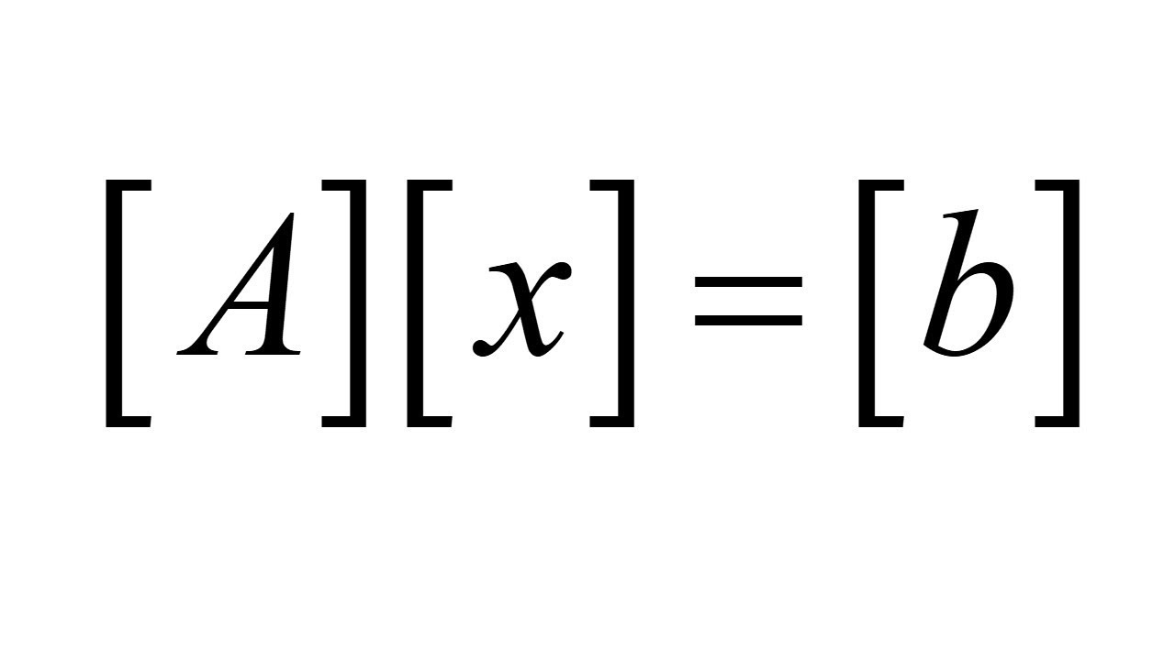


Prerequisites
Prior knowledge of the following domains and technology is helpful:
Linear Algebra
Statistics
Python

Slide 5




Project Highlights
Skills Covered
Arrive at an income qualification model for Inter-American Development Bank with respect to some of the world's poorest families
Numerical Analysis
Machine Learning Algorithms
Text Analysis
Data Visualization Techniques
Data Wrangling
Scalable Machine Learning Models
Develop auto-access models for amazon’s employee access challenge
Design algorithm for Uber that will tell the fare to be charged on the passenger of taxi
Tackle the curse of dimensionality and reduce the time that cars spend on the test bench of Mercedes Benz
© Simplilearn. All rights reserved.

Slide 6
© Simplilearn. All rights reserved.

